Slide 1
Driver Drowsiness Detection System (DDDS)
Name :- Gautam Gupta
Roll No :- 26
Seat Number :- 1067440

Slide 2
INTRODUCTION
A Driver Drowsiness and Sleeping Detection System is a technology designed to help keep drivers alert and safe while they are operating a vehicle. It works by monitoring the driver's behavior and alerting them if it detects signs of drowsiness or sleepiness.
Here's how it works:
Cameras or sensors inside the vehicle track the driver's facial expressions, eye movements, and head position.
The system analyzes these data to identify signs of drowsiness, such as frequent blinking, nodding off, or closing one's eyes for extended periods.
If the system detects these signs, it can sound an alarm, light and stop vehicle engine

Slide 3
AIM OF PROJECT
The objective of a Driver Drowsiness Detection System is to keep drivers safe by alerting them when they are getting too sleepy while driving ,we will be making a drowsiness detection system. A countless number of people drive on the highway day and night. Taxi drivers, bus drivers, truck drivers and people traveling long-distance suffer from lack of sleep. Due to which it becomes very dangerous to drive when feeling sleepy.
The majority of accidents happen due to the drowsiness of the driver. So, to prevent these accidents we will build a system using Python, OpenCV(import cv2), and Keras which will alert the driver when he feels sleepy.
Drowsiness detection is a safety technology that can prevent accidents that are caused by drivers who fell asleep while driving.

Slide 4
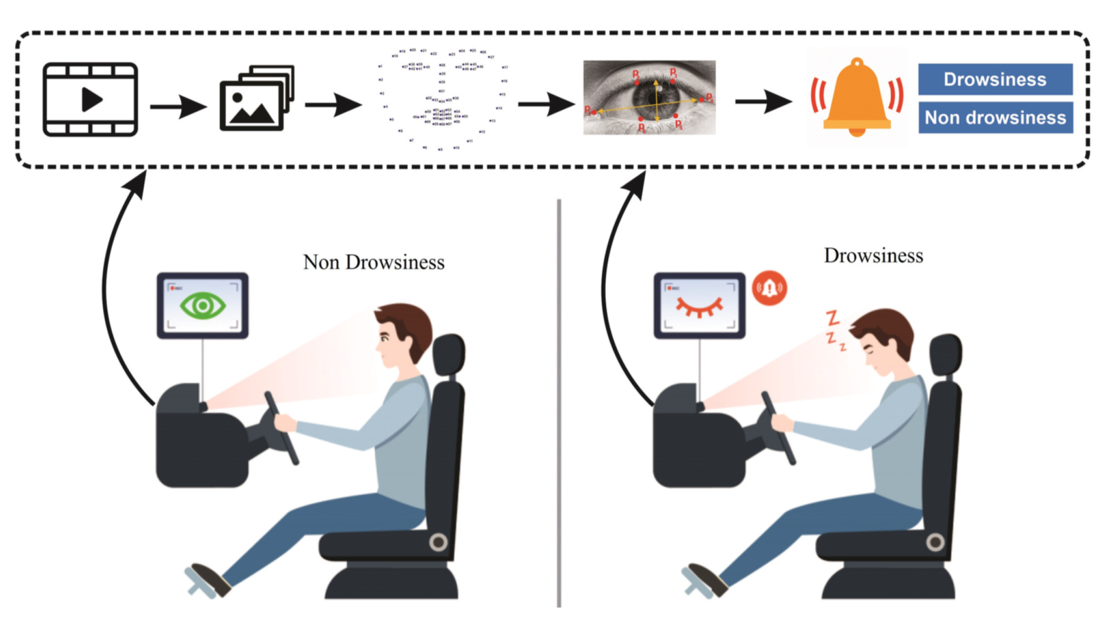
HOW IT WORKS
In this Python project, we will be using OpenCV (import cv2) for gathering the images and Dlib for deep learning based Modules and face landmark detection (import dlib) which will classify whether the person’s eyes are ‘Open’ or ‘Closed’.
Step 1 – Take image as input from a camera.
Step 2 – Detect the face in the image and create a Region of Interest (ROI).
Step 3 – Detect the eyes from ROI and feed it to the classifier.
Step 4 – Classifier will categorize whether eyes are open or closed.
Step 5 – Calculate score to check whether the person is drowsy.

Slide 5
HARDWARE REQUIREMENT
●Hardware components
➢Arduino UNO.
➢Buzzer.
➢DC Motor.
➢Laptop Camera
➢Connecting Wires.
➢LED Red Light.

Slide 6
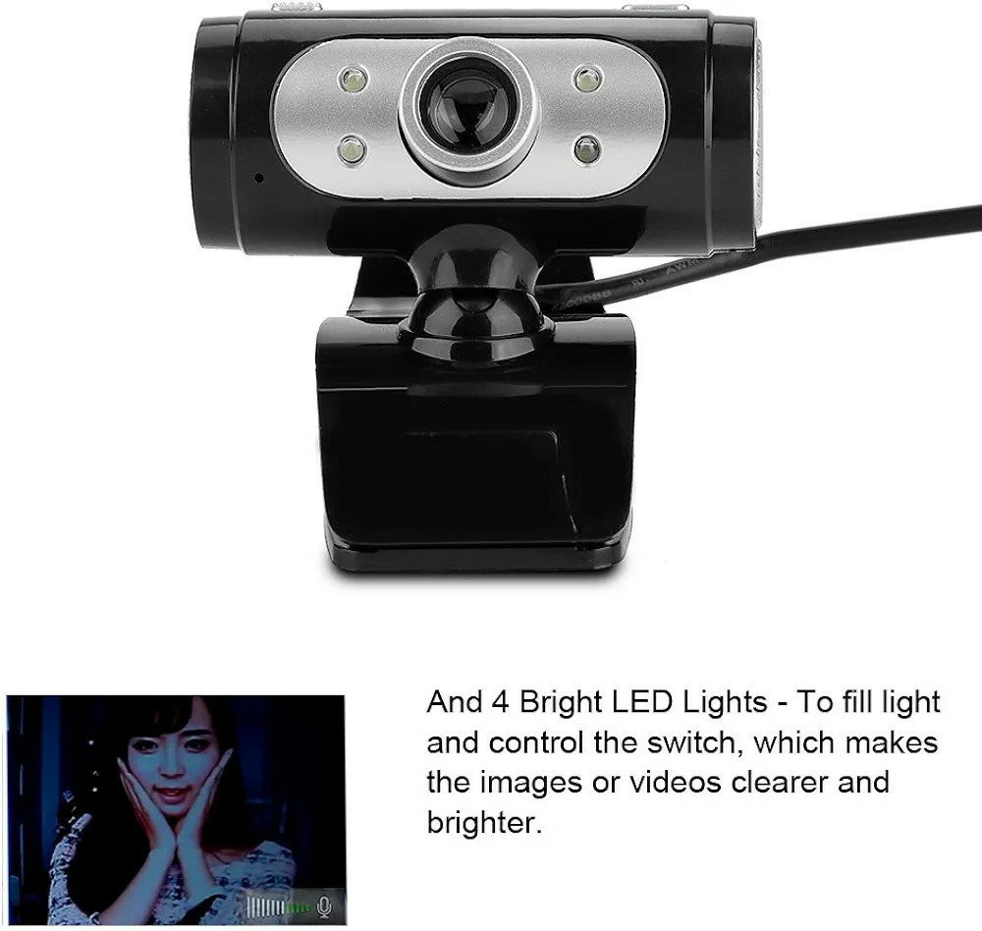
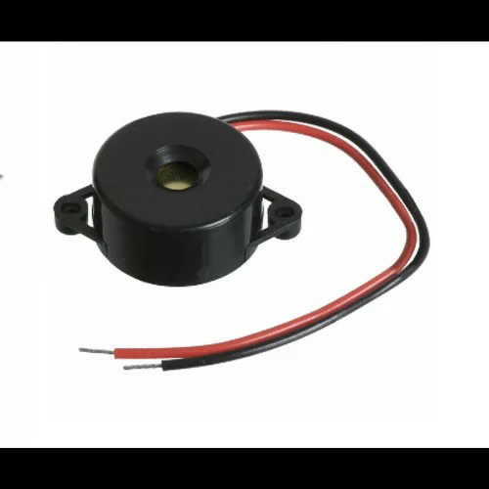
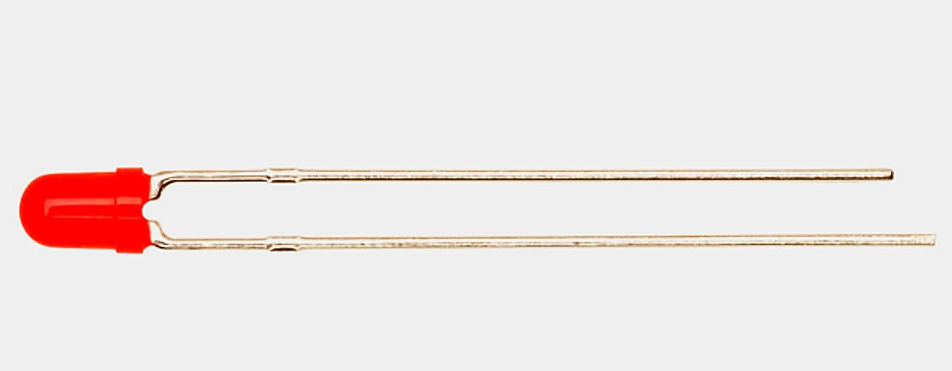
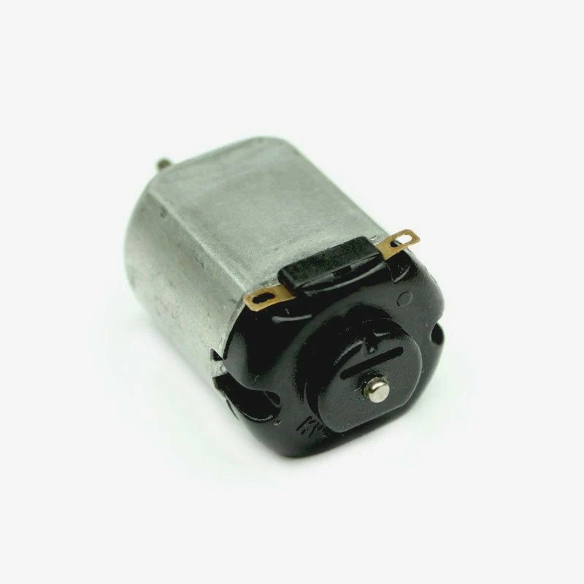
●Cameras: Special cameras keep an eye on the driver's face to check if they look tired or sleeping detect
Figure 2.5.2 : Camera.
●Alarms and Warnings: If the system thinks the driver is too tired, it can make an alarm or alerts may it gives you a warning, like a buzzer or LED Red light ON to wake them up.
Figure 2.5.3 : Buzzer And LED.
●General Motor: General Motors' system in cars can detect if a driver is feeling very tired or sleepy. this system directly turn off the car's engine if the driver is sleepy
Figure 2.5.5 : DC Motor.

Slide 7
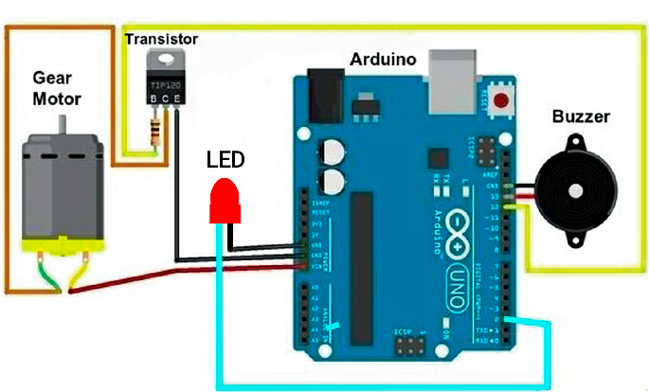
CIRCUIT DIAGRAM :
The circuit diagram for Driver Drowsiness and Sleep Detection System contains a components : Arduino Uno, Camera, Buzzer, LED and Gen- Motor.
Figure : Circuit Diagram.

Slide 8
1. Arduino Uno Connections:
Connect the Arduino Uno to a power supply with +5V and GND pins.
2. PC Camera Connection:
Connect the PC camera to the Arduino Uno via USB for capturing images.
3. LED Connection:
Connect the LED's positive leg (anode) to a digital output pin number - 9 on the Arduino Uno.
Connect the LED's negative leg (cathode) to a current-limiting resistor (220-330 ohms).
Connect the other end of the resistor to the GND pin on the Arduino Uno.
4. Buzzer Connection:
Connect the buzzer's positive terminal to another digital output pin number - 8 on the Arduino Uno.
Connect the buzzer's negative terminal to the GND pin on the Arduino Uno
5. DC Motor Connection:
Connect the DC Motor to digital output pin number - 10 on the Arduino Uno.
Connect the motor driver's VCC and GND pins to the Arduino Uno's +5V and GND pins, respectively.

Slide 9
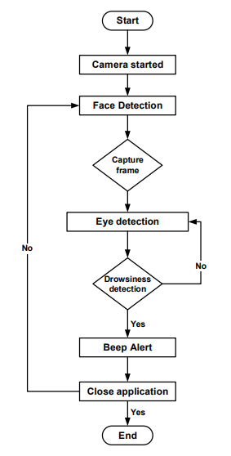
❖ Step for Flowchart Diagram :-
Step 1- Start: Begin the process.
Step 2- Camera Started: Activate the camera to start capturing real-time video Frame.
Step 3- Capture Frame: Continuously capture frames from the camera.
Step 4- Eye Detection: Analyze each frame to detect the driver's eyes.
Step 5- Drowsiness Detection:
The level of drowsiness based on eye movement patterns.
If yes, activate the alert mechanism.
If no, continue monitoring.
Step 6- Beep Alert: If drowsiness is detected, trigger a beep alert to notify the driver.
Step 7- Close Application: End the process and close the application.
Step 8- End: Finish the process.

Slide 10
ADVANTAGES OF THE SYSTEM :-
1. Early Warning System:
2. Safety Enhancement:
3. Reduced Accident Rates:
4. User-Friendly Interface:
5.Cost Savings:
LIMITATION OF THE SYSTEM :-
1. Reliance on Visible Cues:
2. Limited Detection Capability:
3. False Sense of Security:

Slide 11
Thank you..

